Slide 1
EID 403: Machine Learning
Lecture 01
Introduction to Machine Learning
Dr. R. Sireesha
Professor
Dept of CSE,
GITAM Institute of Technology
GITAM Deemed to be University

Slide 2
Prerequisites
Foundations of Algebra and Calculus
Statistics
Python Programming
Programming Setup
Jupyter Notebook or Anaconda
Python
Google Colab (optional)
GitHub (Optional)

Slide 3
Outline of the Course
Introduction
Neural Networks and Genetic Algorithms
Bayesian and Computational Learning
Instance based Learning
Hidden Markov Models
Textbooks
Tom M. Mitchell, Machine Learning, McGraw Hill , 2013. (Modules 1-4)
Ethem Alpaydin, Introduction to Machine Learning (Adaptive Computation and Machine Learning), The MIT Press, 2004 (Module 5)

Slide 4
Assessment Procedure for the Course
30 marks for the mid semester examinations
10 marks for quizzes, programming assignments and reports.
60 marks evaluated by semester-end examination
Points to Note:
Plagiarism/Content Overlap in any form (programming/text, internal/external ) is discouraged. Students found indulging in it will be awarded negative marks.

Slide 5
Lecture Outline
Learning Objective: to understand the significance of machine learning in daily life
Introduction
What is Machine Learning?
Impact on Society & Science
Learning Algorithms
Machine Learning Lifecycle
Python Programming
Introduction to Python
Understanding Jupyter Notebooks
Pandas/Numpy/Matplotlib
Practice Exercises

Slide 6
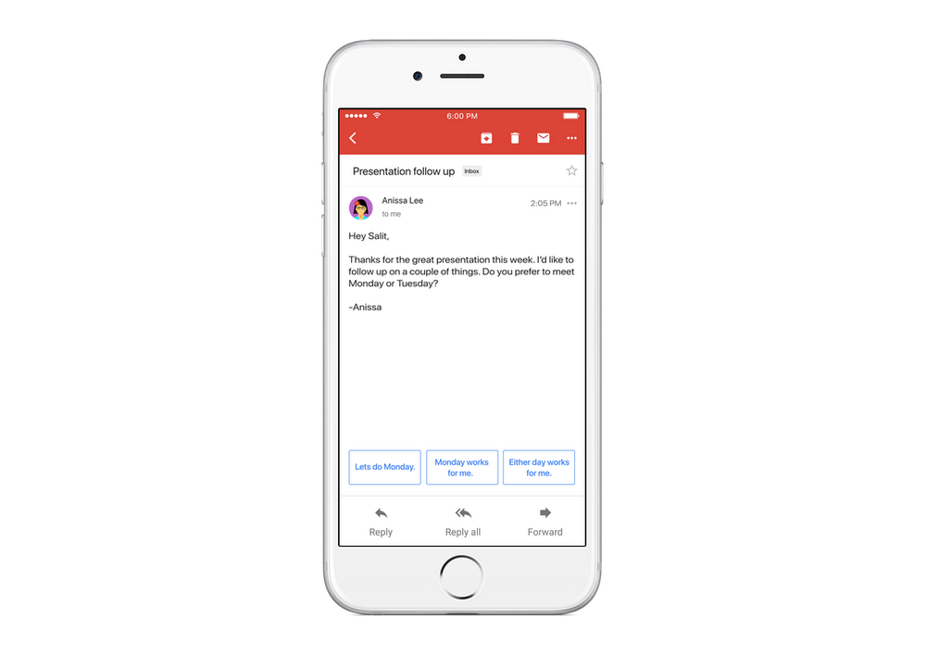




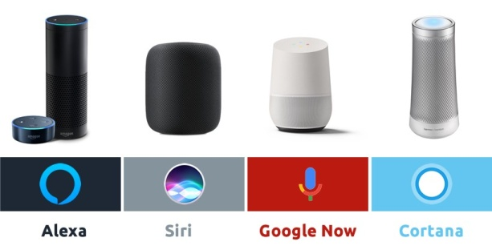
The all-pervasive Machine Learning Waking up to ML
Travel
Voice Assistants

Slide 7




The all-pervasive Machine Learning Starting for Work/College

Slide 8





The all-pervasive Machine Learning When at Work/College

Slide 9



The all-pervasive Machine Learning When at Home

Slide 10

How can ML help save our Planet?
Machine Learning may be employed to create a better world by addressing complex environmental issues such as climate pollution, water scarcity, extinction of species etc.
It may be used to prevent the adverse effects that threaten the existence of biodiversity. According to a report published by Intel in 2018, 74% of the 200 professionals in the field survey agreed that AI can help solve environmental challenges.

Slide 11
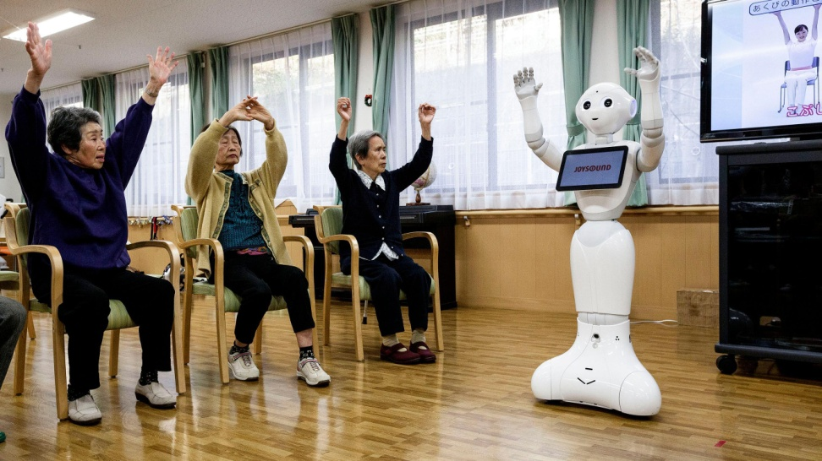
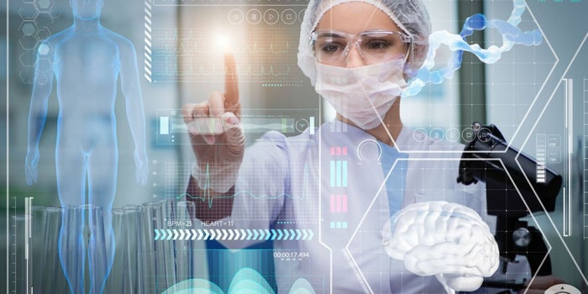
How can ML help Human Lives?
Machine Learning can bring about a transformative impact on healthcare and its applications spanning from drug delivery to diagnostics, consumer health and more.
A number of such applications are in use today viz., personal health assistants, wearable fitness technology, telehealth apps.

Slide 12

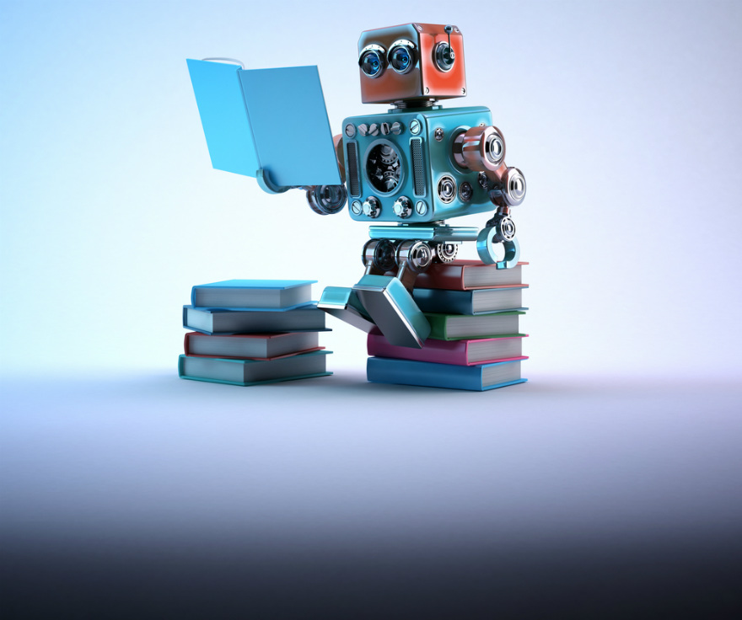
Machine Learning

Slide 13
Machine Learning Outcome
Recognize
Predict
Act
Based on the patterns of previous experiences or data

Slide 14



Machine Learning Framework
Apply a prediction function to a feature representation of the image to get the desired output.
f( )=Apple
f( )=Tomato
f( )=Cherry

Slide 15
Machine Learning Framework
y=f(x)
Training: Given a set of labeled examples {(x₁,y₁),(x₂,y₂),…(x_{n},y_{n})}, estimate the prediction function f by minimising the prediction error in the training set.
Testing: Apply “f” to a never before seen test example x and output the predicted value y=f(x)

Slide 16
What is a Learning Problem
Learning = Improving with experience at some task
Improve over task T ,
with respect to performance measure P ,
based on experience E.
E.g., Learn to play checkers
T : Play checkers
P : % of games won in world tournament
E: opportunity to play against self

Slide 17
Well-posed Problem
Identify three features
Class of tasks
Measures of performance to be improved
Source of experience

Slide 18
Well-posed Problem: Example
Robot Driving Problem
Task T: Driving on public,4-lane highway with vision sensord
Performance measure, P: average distance travelled before an error (as judged by a human overseer)
Training Experience E: a sequence of images and steering commands recommended while observing a human driver.

Slide 19
Well-posed Problem: Example
Handwriting Recognition Problem
Task T: recognizing and classifying handwritten words within images
Performance measure, P: percent of words correctly classified
Training Experience E: a database of handwritten words with given classifications.

Slide 20
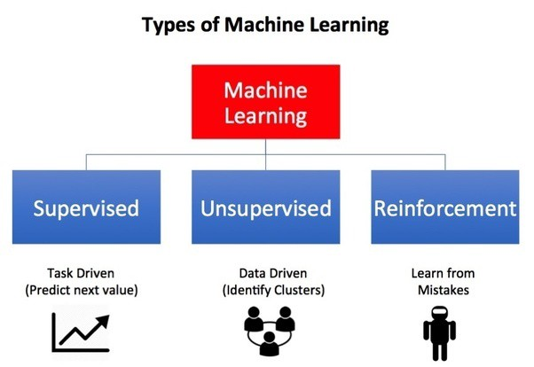
Machine Learning

Slide 21
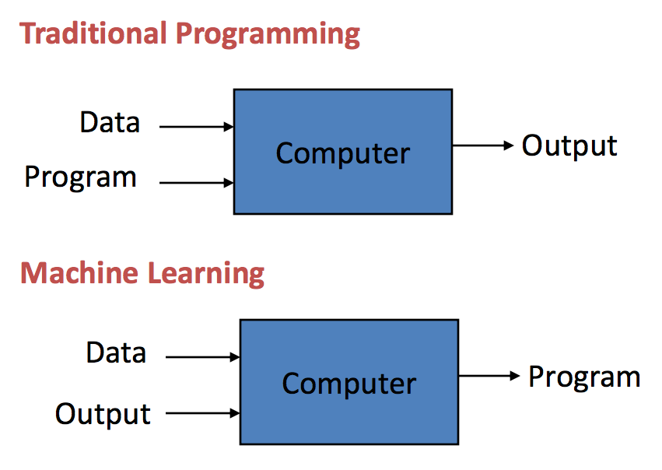
Software Programming Perspective

Slide 22
Some Applications
Recognizing Handwritten words
Recognizing Spoken words
Predict recovery rates for Covud-19 patients
Detect fraudulent use of credit cards
Drive autonomous vehicles on highways
Play chess against a human chessmaster

Slide 23
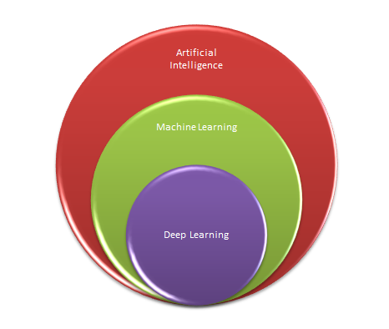
AI, ML, DL

Slide 24
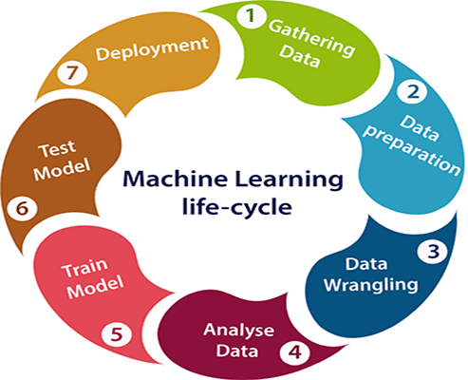
Life Cycle of Machine Learning

Slide 25

Predict Customer Retention
Data Preprocessing
Feature Engineering
Predict Customer Retention using Logistic Regression
Functions to meet the objective of high accuracy

Slide 26
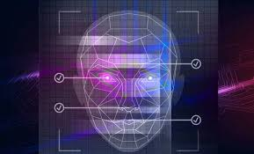
Image Recognition
Image Processing
Data Preparation
Recognize images using SVMs
Recognize images using Neural Networks/ Deep Learning
Evaluate accuracy of predictions

Slide 27

Sentiment Analysis
Text Data Preparation
Text data Preprocessing
Natural Language Processing
Classify text using Support Vector Machines
Visualizing the results

Slide 28
Issues in Machine Learning
What algorithms exist?
How much training data is sufficient?
When and how can prior knowledge held by the learner guide the generalization process from examples?
What is the best strategy for choosing the next best training example?
How to alter the learning mechanism automatically to better learn the target function?

Slide 29


Slide 30


